Slide 1
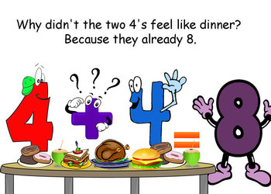
Number
Term 1
Semester 1
Teacher:
Class:

Slide 2
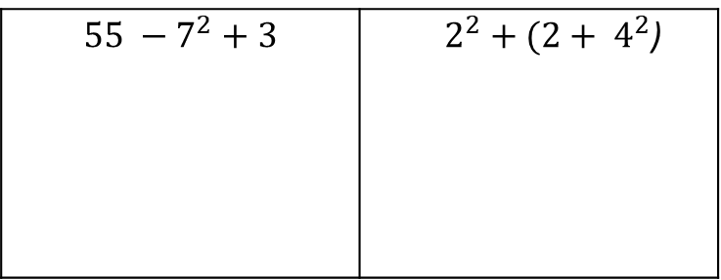
24
7
30
Topic: wages and salaries
Date
Essential Question:
What is the difference between a wage and a salary?
Questions
Notes:
REVISION QUESTIONS
$$55 −7^{2}+3$$ | $2^{2}+(2+ 4^{2}$)
Round these numbers to 2 dp
167.989
17.7513
5

Slide 3
24
7
30
Topic: wages and salaries
Date
Essential Question:
What is the difference between a wage and a salary?
Questions
Notes:
What is a wage?
An amount paid each worked
What is a salary?
A fixed amount per year that does not depend upon the number of hours worked.
1 year = 365 days
1 year = 12 months
1 year = 52 weeks
1 year = 26 fortnights
5

Slide 4
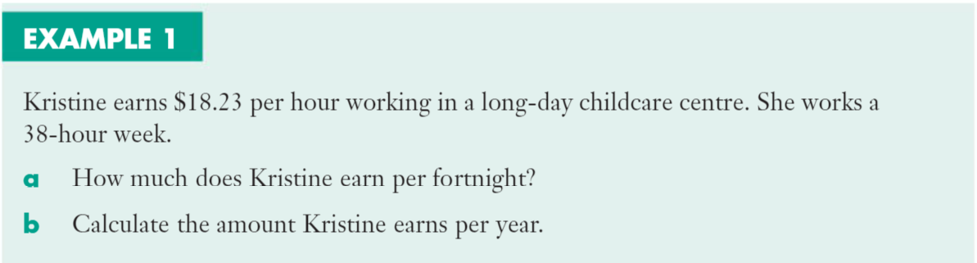

Slide 5
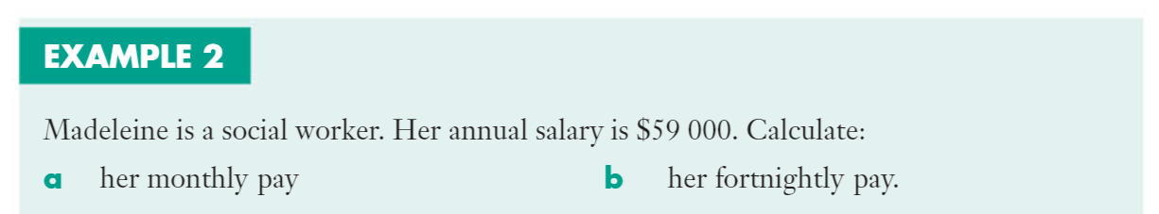

Slide 6
Exercise 8.01 – page 204

Slide 7
